Slide 1
Introduction to Social Stress Resilience
Resilience = Neural Resistance to Stress Over-responsiveness
Anxiety or Depression

Slide 2
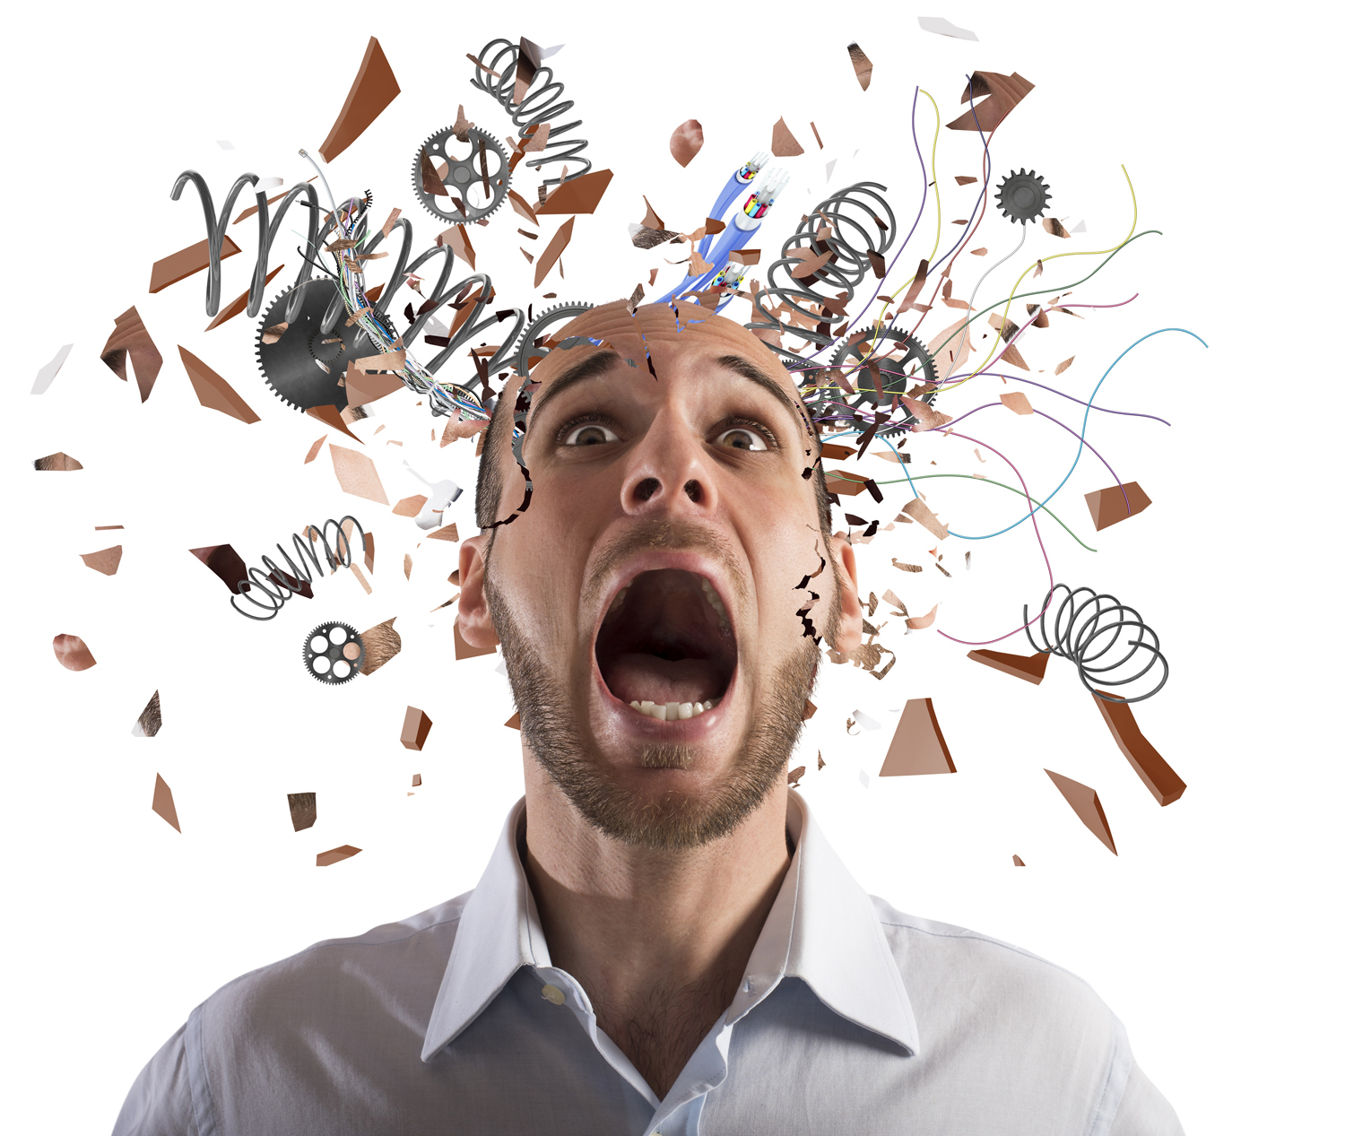
Why do Individuals respond Differently? - To Stress?
Why are some people more stressed out?
Why are some people more prone to Anxiety?
Especially Social Anxiety?
Why do some people become Depressed?
Why is Depression hard to recover from?
How is it that some people avoid Anxiety and Depression?
Why are some Vulnerable and some Resilient?

Slide 3
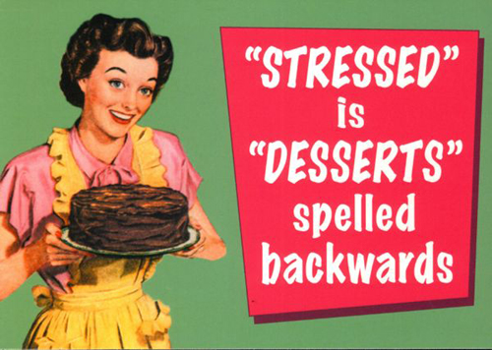
Don’t Forget

Slide 4
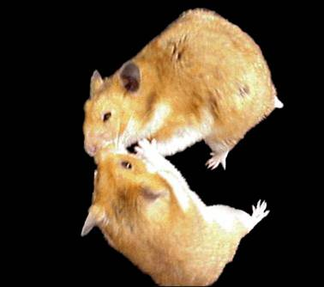
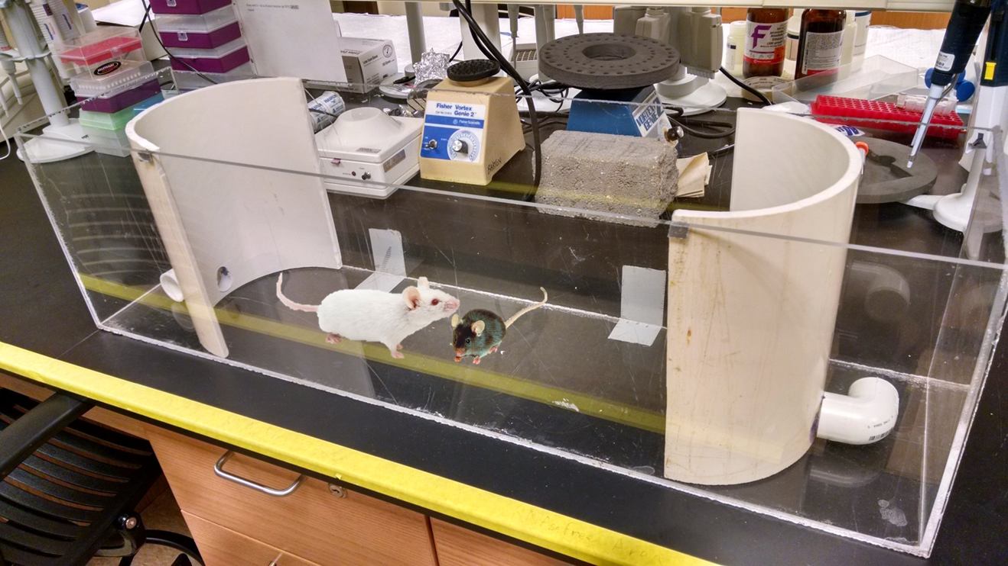
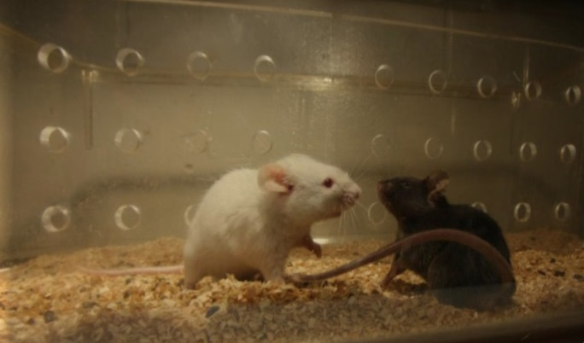
Models of Social Stress
Male only Models
Pose a Problem for
Understanding
Anxiety and
Depression
-But-
Social Stress is the most clinically relevant
Resident-Intruder
Conditioned Defeat – Hamsters only
Chronic Social Defeat
Stress-Alternatives Model

Slide 5
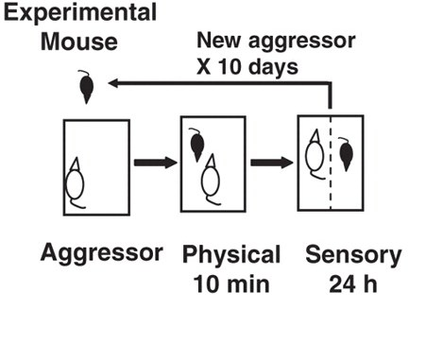
Social Defeat Model
10 days
10 min / day together
23h 50 min / day cohabitation: one on each side of the divider
CD1
aggressor
C57Bl6

Slide 6
Effects of Social Defeat on Stress Hormones
Social Defeat produces:
Animals Susceptible to Stress
Anxiety
Depression
Animals Resilient to Stress
Anxiety
Depression
What does it mean?
If their plasma B levels are equally elevated?
Resilient

Slide 7
These are NOT surprising results
Social Defeat is very stressful
Much more effective
stimulating Neuroendocrine stress responses
than other kinds of stresses
All Individuals
MUST respond to Stress
Lack of response can be fatal
Resilient

Slide 8
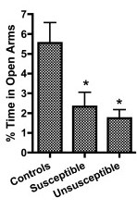
Effect of Social Defeat on General Anxiety
Elevated Plus Maze
Resilient
EPM

Slide 9
Why
Some commonly used Tests
Of Anxiety
and Depression
Do not translate well into positive clinical results
EPM is one of those tests
General Anxiety
Resilient

Slide 10
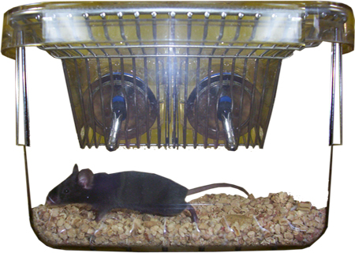
Effect of Social Defeat on Anhedonia
Depression is characterized by
Despair
Loss of interest in pleasure
Anhedonia can be measured
Sucrose Preference Test
Choice between
H₂O
H₂O = 1% sugar
Resilient

Slide 11
Effect of Social Defeat on Circadian Dysfunction
All individuals with Depression
Exhibit disrupted Circadian Rhythms
Usually Phase Delay
Often muted Amplitude
Lower Morning Cortisol peaks
Reduced Temperature peaks

Slide 12
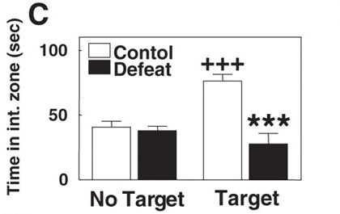
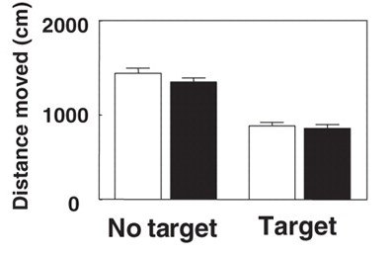
Effects of Social Defeat on Social Anxiety and Depression
Social
Interaction
Test

Slide 13
After Social Defeat: Different Populations Emerge: Susceptible and Resilient
Resilient Individuals
Spend as much time
As Undefeated mice
Interacting with a potential aggressor
NO Social Anxiety
No Behavioral Withdrawal or Depression

Slide 14
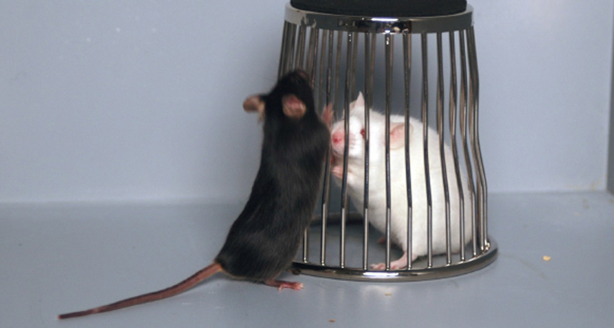
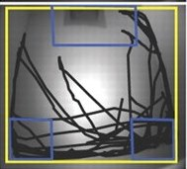
Social Preference Score (100 = neutral)
Resilient

Slide 15
Susceptibility and Resilience
So Some Individuals are
Vulnerable to Stress, Anxiety, and Depression
Not all tests show it
Not all tests are clinically translatable
Usually on Social Tests
Resilient to Stress
Resilient Individuals have
Less Anxiety, and Depression

Slide 16
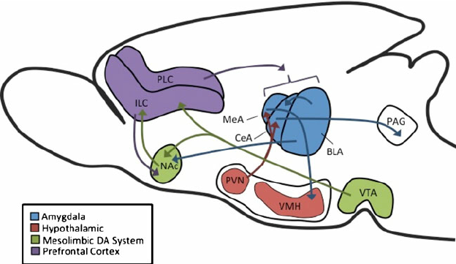
What Neurocircuitries produce changes in susceptibility and Resilience?
Reward Circuitry
Fear Circuitry
DA
VTA = Ventral Tegmental Area
(makes Dopamine = DA)
NAc = Nucleus Accumbens
- Ventral Striatum
- DA is released in NAC

Slide 17
Why the Reward Circuit?
Reward
produces ↑ DA release in NAc
Made in VTA released in NAc
Expectation of Reward
produces ↑ DA release

Slide 18
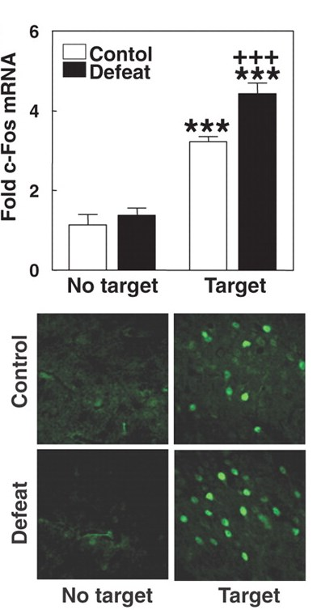
Why the Reward Circuit?
Marker of Neural Activity
Reward
produces ↑ DA release
Expectation of Reward
produces ↑ DA release
Lack of Expected Reward
Anhedonia
NAc
DA

Slide 19
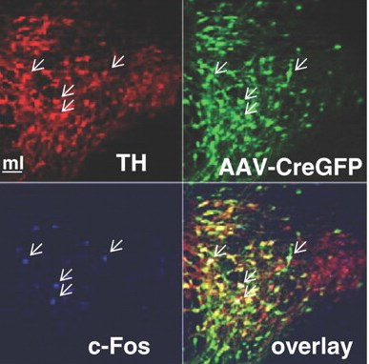
Why the Reward Circuit?
Cre = DNA cutter
GFP = color
Green Florescent Protein
Defeat-related ↑ c-Fos
Found in dopamine (DA) neurons
Tyrosine Hydroxylase (TH) = rate limiting enzyme producing DA
Found in BDNF neurons
DA neurons make BDNF
Marked by
AAV- transfected
-CreGFP
NAc
DA

Slide 20
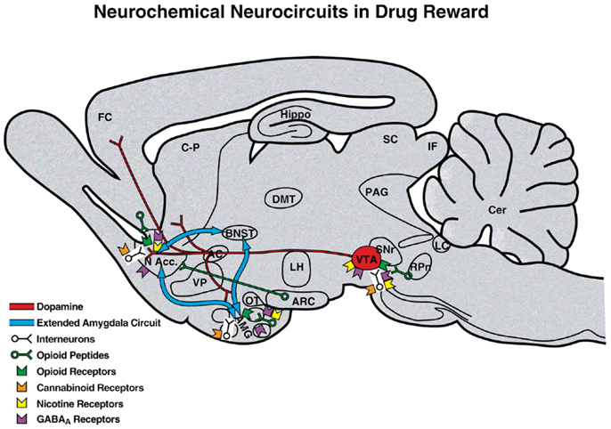
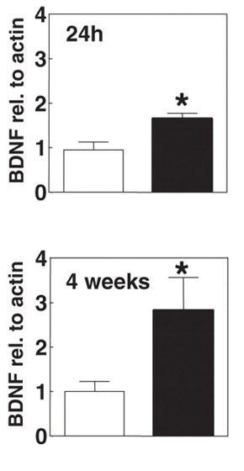
NAc BDNF is made in the VTA
What is BDNF, why is it important?
Brain Derived Neurotrophic Factor
Stimulates Neuronal:
Growth and Development
Maintenance
Neurite Outgrowth
Dendritic Spines
Synaptic Formation and Plasticity
Activity and Potentiation (LTP)
Promotes Learning and Memory

Slide 21
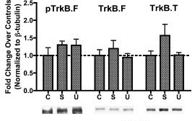
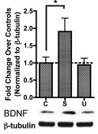
BDNF binds → TrK_{B} Receptor TrK_{B} → Akt, GSK_{3β}, ERK
NAc BDNF Receptor:
Trk_{B} = Tropomyosin receptor Kinase B
2nd Messengers:
Akt = Protein Kinase B
GSK_{3β} = Glycogen Synthase Kinase 3beta
ERK_{1&2} = Extracellular Signal-Related Kinases = MAP K, MAPKK
Increased in Susceptible mice
Reduced in Resilient mice

Slide 22
BDNF activity in Reward Circuits Promotes Vulnerability to Stress, Anxiety, Depression
BDNF in NAc →↑ Stress, Anxiety, Depression
but
BDNF in Hippocampus
reduces
Stress, Anxiety, Depression
BDNF effects depend on circuitry

Slide 23
Chronic Antidepressant promotes Social Interaction (Resilience)
Imipramine
tricyclic antidepressant
serotonin (5-HT) and
norepinephrine (NE) reuptake inhibitor +
Fluoxetine (Prozac)
5-HT reuptake inhibitor
Time in Interactive Zone

Slide 24
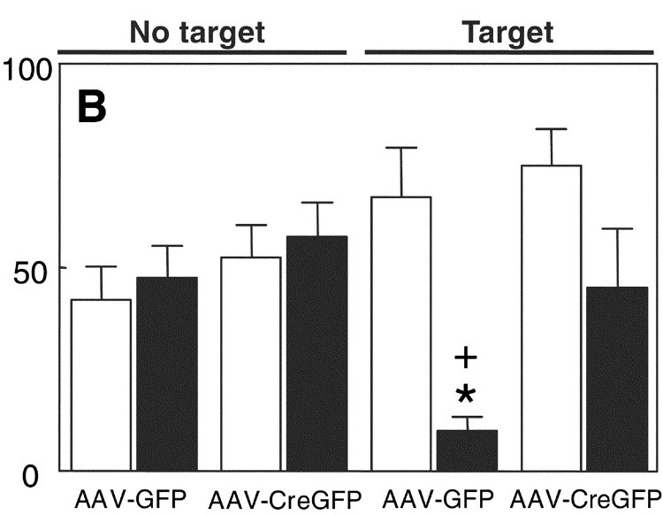
Testing the Role of BDNF in NAc
Adding BDNF to NAc
↓ Resilience
Blocking BDNF
BDNF Knockdown
or Blocking ERK
i.e. Blocking BDNF downstream effects
↑ Resilience
BDNF KD

Slide 25
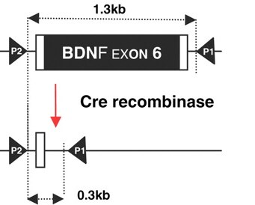
Knockdown of the BDNF gene NAc vs VTA

Slide 26
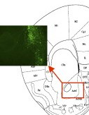
NAc Knockdown of the BDNF gene
BDNF KD in NAc
Doesn’t effect
Defeat-induced
reduction in
Social Interaction
Why?
BDNF KD
BDNF isn’t made in NAc, only released there

Slide 27
Knockdown of the BDNF gene NAc vs VTA
VTA BDNF KD reverses depression-induced
Weight loss
VTA BDNF KD
limits
Anhedonia

Slide 28
What molecular mechanisms drive Social Defeat-induced Resilience or Vulnerability?

Slide 29
What molecular mechanisms drive Social Defeat-induced Resilience or Vulnerability?
Susceptible Individuals:
Faster Firing
VTA → NAc DA neurons
Due to lack of
inward rectifying K⁺ channels (Kir2.1)
Knock in →↓ Firing
Dominant negative → ↑ Firing

Slide 30
Transfection of Kir2.1 into VTA → NAc neurons
Increases Social Interaction
Time
Decreases VTA→NAc neuron
BDNF gene expression
Promotes Resilience

Slide 31
Translation to Humans
Humans with BDNF gene SNP
Val66Met/G196A
single-nucleotide polymorphism
have more depression
Val/Val mutant mice
lower social interaction
More NAc BDNF
Depressed people have
↑ NAc BDNF levels

Slide 32
Developing Social Defeat Vulnerability

Slide 33
Science should always generate more questions: Does this model explain everything about the etiology of depression ?
Etiology: cause, set of causes, or manner of causation

Slide 34
Here’s a question for you
Why do animals (humans too?) get warmer following social interaction?

